Slide 1


Slide 2
About today…
Error Handling
Error Handling / Exceptions
Debugging Techniques

Slide 3


Slide 4

Introduction to Error Handling
Question
What do you think happens when an error occurs in PHP?
Answer
PHP tries to handle the error internally, but sometimes it needs our help
Importance
Ensures the smooth functioning of your application and provides better user experience
Types of Errors
Notices
Warnings
Fatal Errors
Parse Errors
Interactive Activity
Share examples of errors you've encountered

Slide 5




Types of Errors
Notices
Minor issues
e.g., using an undefined variable. Doesn't stop script execution
Warnings
More serious
e.g., including a missing file. Doesn't stop script execution
Fatal Errors
Critical
e.g., calling a non-existent function. Stops script execution
Parse Errors
Syntax mistakes
e.g., missing semicolon. Stops script execution

Slide 6


Error Reporting Levels
Set the level of error reporting to control which errors are shown
C:\xampp\php\php.ini
E_ALL
All errors and warnings
E_ERROR
Fatal run-time errors
E_WARNING
Run-time warnings (non-fatal errors)
E_NOTICE
Run-time notices
Example

Slide 7
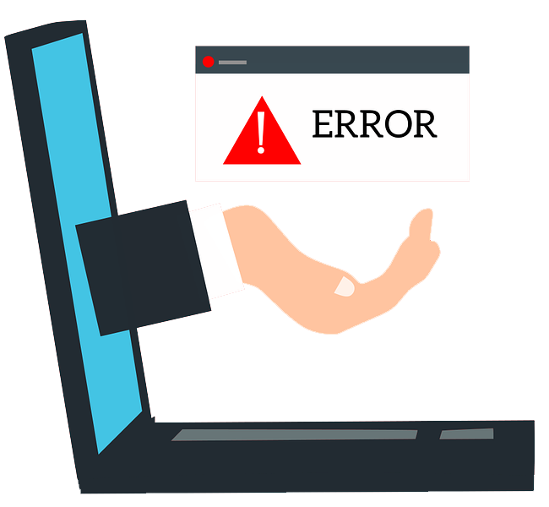


Basic Error Handling
Set the level of error reporting to control which errors are shown
ini_set('display_errors', 1);
error_reporting(E_ALL);

Slide 8
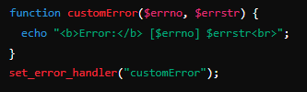

Custom Error Handling
Creating your own error handler function
set_error_handler()
Define your own function to handle PHP errors

Slide 9
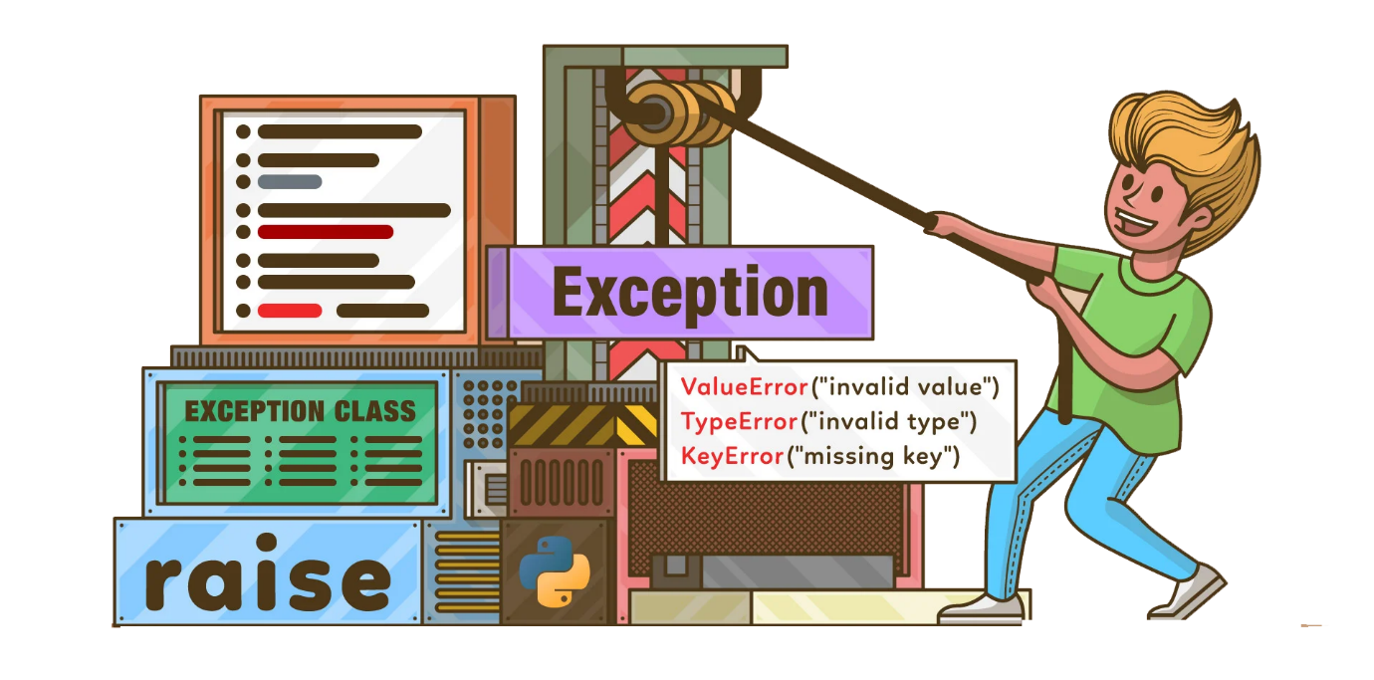
Introduction to Exceptions
Definition
Exceptions are special objects used to handle errors in PHP gracefully
Difference
Exceptions are special objects used to handle errors in PHP gracefully
Interactive Question
“ How do you think exceptions might make error handling easier? “

Slide 10

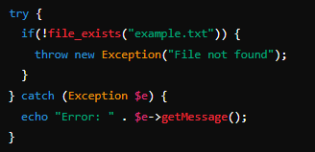
Basic Exception Handling
try
Encloses code that might throw an exception
catch
Catches exceptions thrown in the try block
throw
Throws an exception explicitly

Slide 11

Debugging Techniques
var_dump()
Shows structured information about variables and their contents
print_r()
Prints human-readable information about variables
debug_backtrace()
Throws an exception explicitly

Slide 12

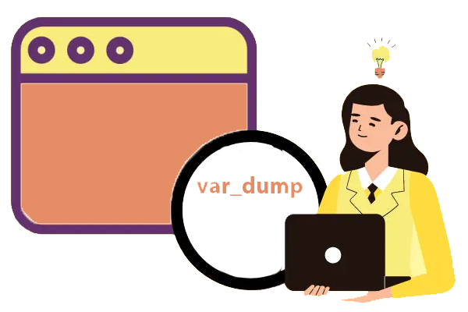
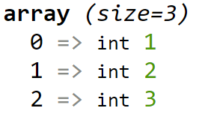
Using var_dump()
Shows structured information about variables and their contents
Example

Slide 13



Using print_r()
Shows array in the form of [index] => value
Example

Slide 14
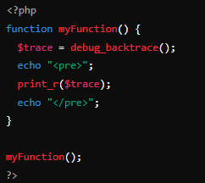
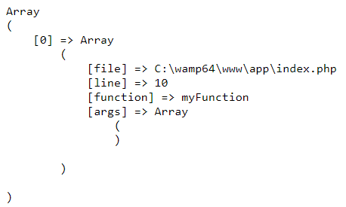

Using debug_backtrace()
Shows function and its details in the form of array
Example

Slide 15


Slide 16

Which method would you use to see detailed information about a variable's type and value?
Why is error logging important in PHP?
How do you set PHP to report all types of errors?
Which error type does PHP issue when a critical failure occurs that stops the script?
What is the purpose of try and catch blocks in PHP?

Slide 17

Task 1
Create a simple try-catch block and handle an exception
Task 2
use var_dump() to explore different variables and see what information we get.
Task 3
Create a simple try-catch block and handle an exception
Task 4
Create a function and trace its call stack using debug_backtrace()

